Slide 1

Machine Learning:
Predicting Electric Vehicle Growth and Sustainability
David Nichols
John Smith
Kojo Buansi
Patrick Cur

Slide 2

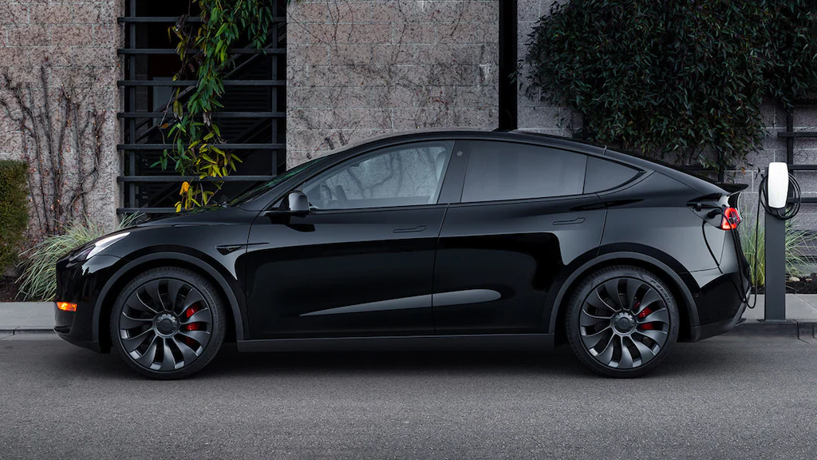
Motivation
Cleaner end-user emissions
Push for more EV’s from private sector and governments around the world
Social push for “Clean Energy”
Notes:
john

Slide 3
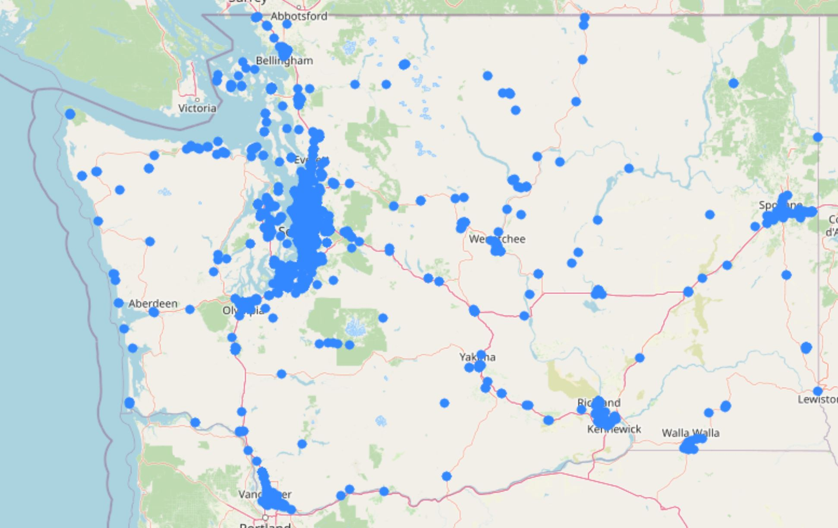
Project Overview
What is the growth of new EV?
Where are new stations needed?
Can the power grid handle the additional load of these new EV’s?
Notes:
john-We did our project on Electric Vehicles. Specifically vehicles and charging station growth. As well as the affect on the grid.
We decided to narrow our project to the state of Washington, This was done due to the available datasets from washington.

Slide 4
Datasets
Kaggle : Electric Vehicle Charging Stations
Author: James Lemieux (Kaggle)
Storage Size: 3.35Mb
Total Data Points: 53892
Filtered to WA: 51409
Data.wa.gov : Electric Vehicle Title and Registration Activity
Author: State of Washington (catalog.data.gov)
Storage Size: 279Mb
Total Data Points: 633873
Filtered to Original Title: 633870
Filtered to Unique VIN: 633818
Notes:
john-To do this we used three datasets.
The dataset for the power grid was chosen due to it only showing the transportation sector.

Slide 5
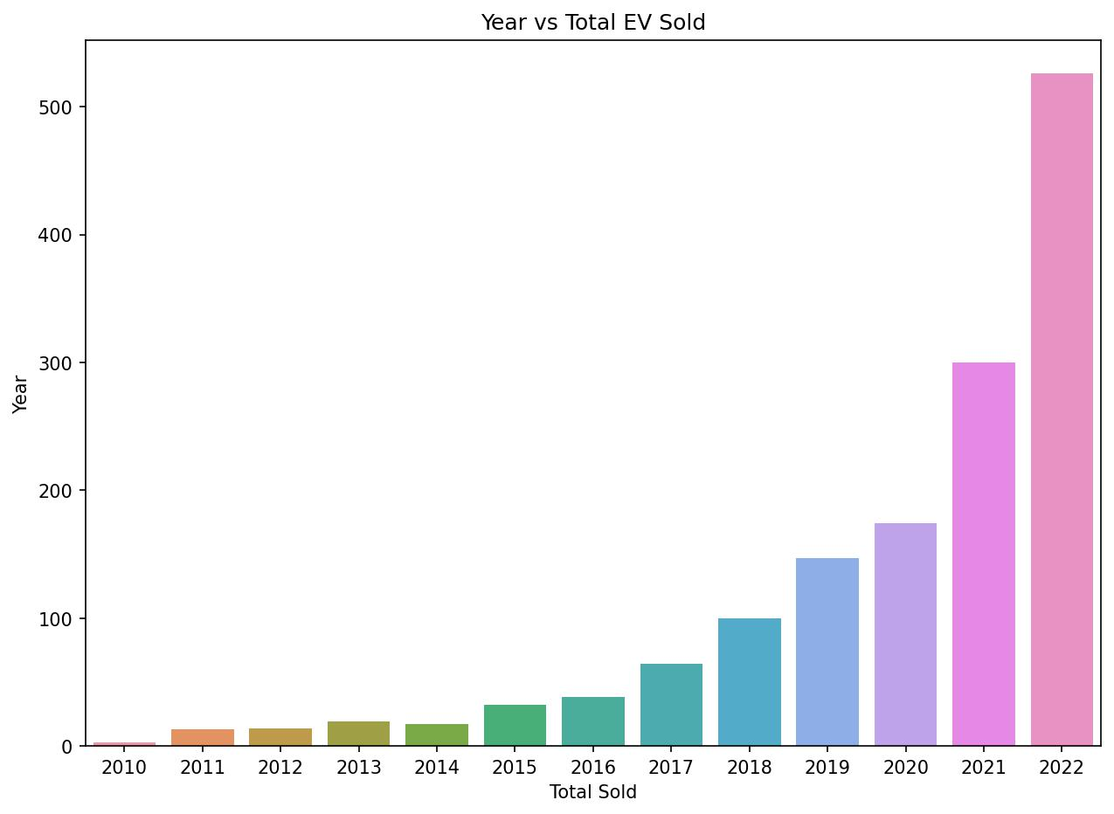
Electric Vehicles
Total Number of Sold EVs
Total Number of EVs Until 2021: 924
Total Sold EVs to Date: 1,447
Notes:
john

Slide 6
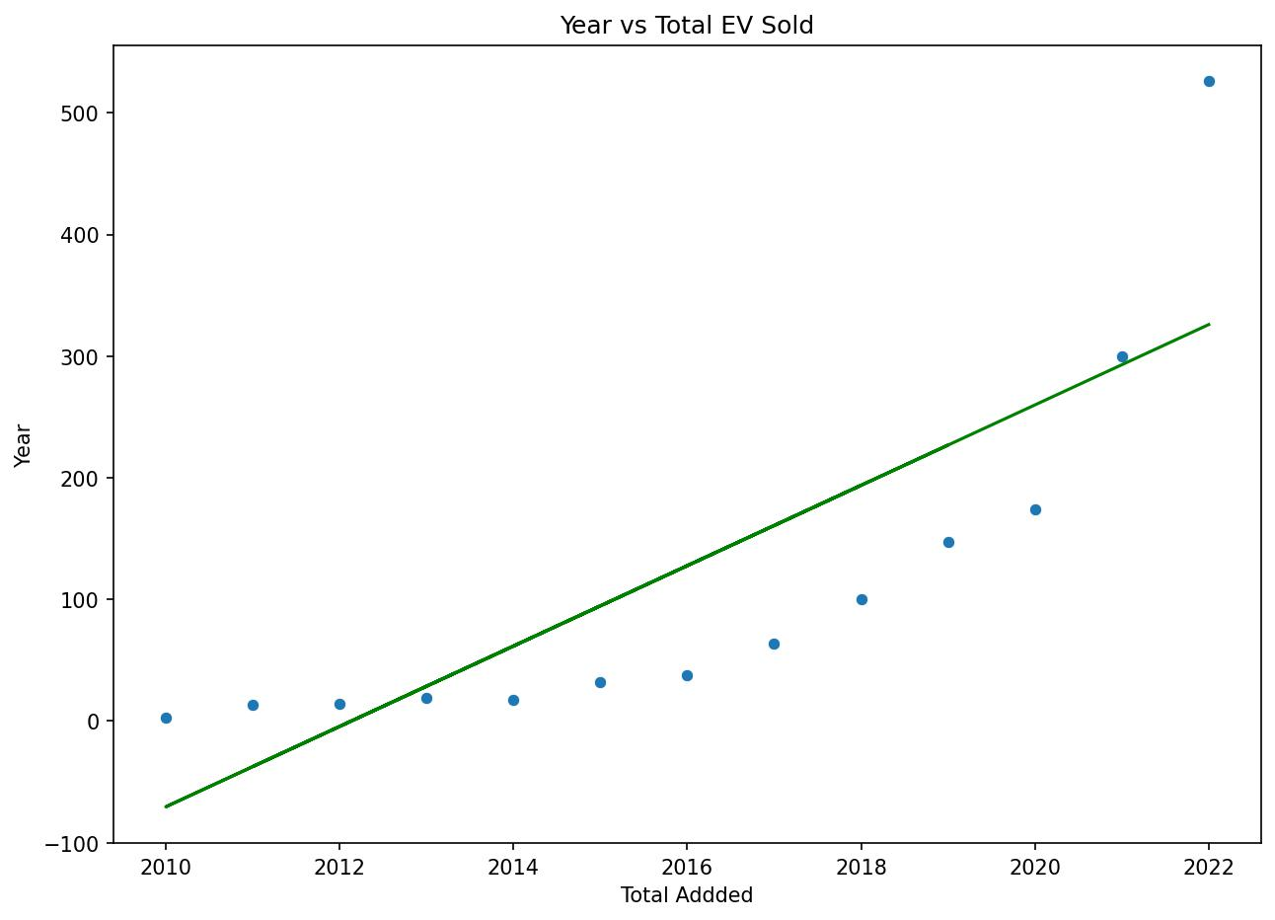
EV Sold Predictions
Slope: 33.04307432
Intercept: -66487.13766892
MSE: 8540.63954579545
RMS error: 92.41558064415031
R2 score: 0.6514087911686
Notes:
Charging stations have a massive effect on the grid

Slide 7
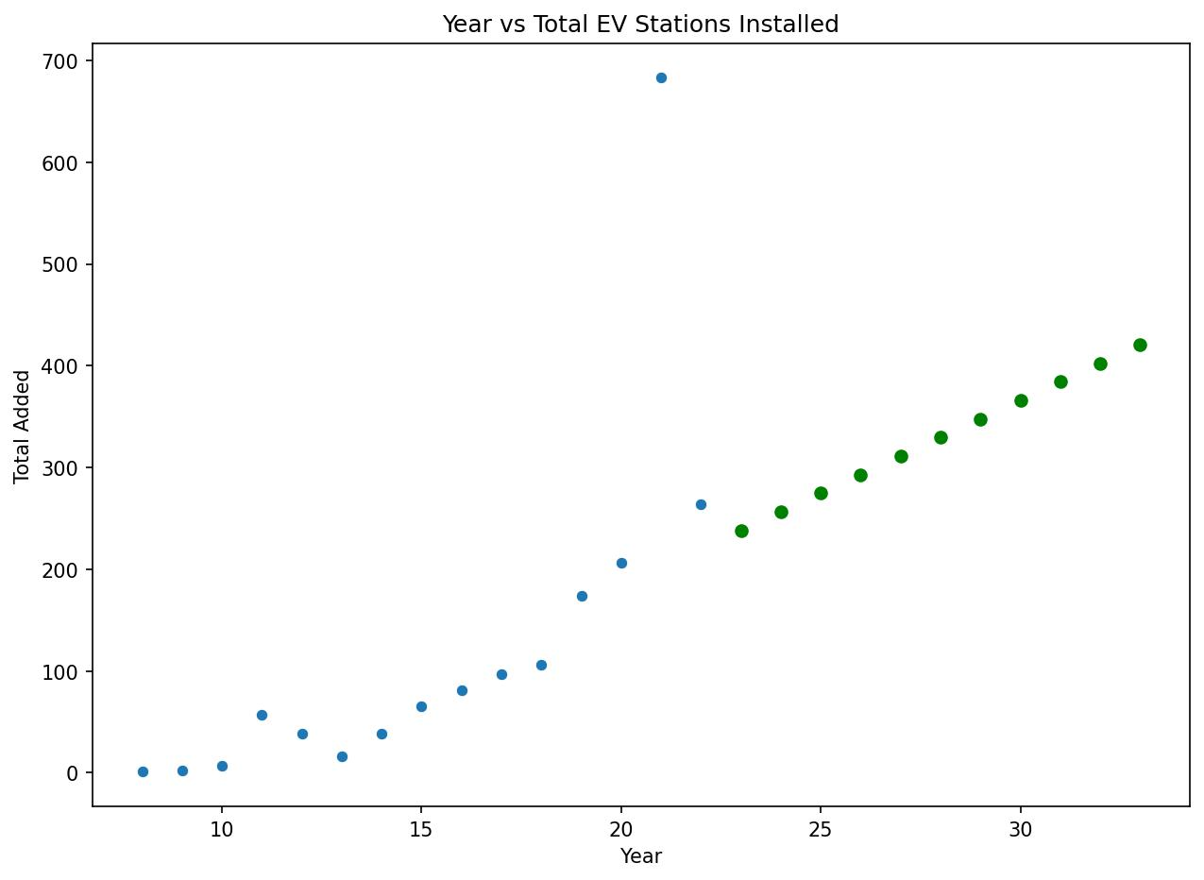
EV_Sold Predictions
Total Number of Predicted Vehicles
Total Predicted Vehicles from 2022 to 2033: 5764

Slide 8
Issues Faced
Keras Neural Network high loss no usabled data due to not enough data points (loss of 34759.1875)
SVM accuracy of 0
Tpot had a score of -8414.387348232205

Slide 9
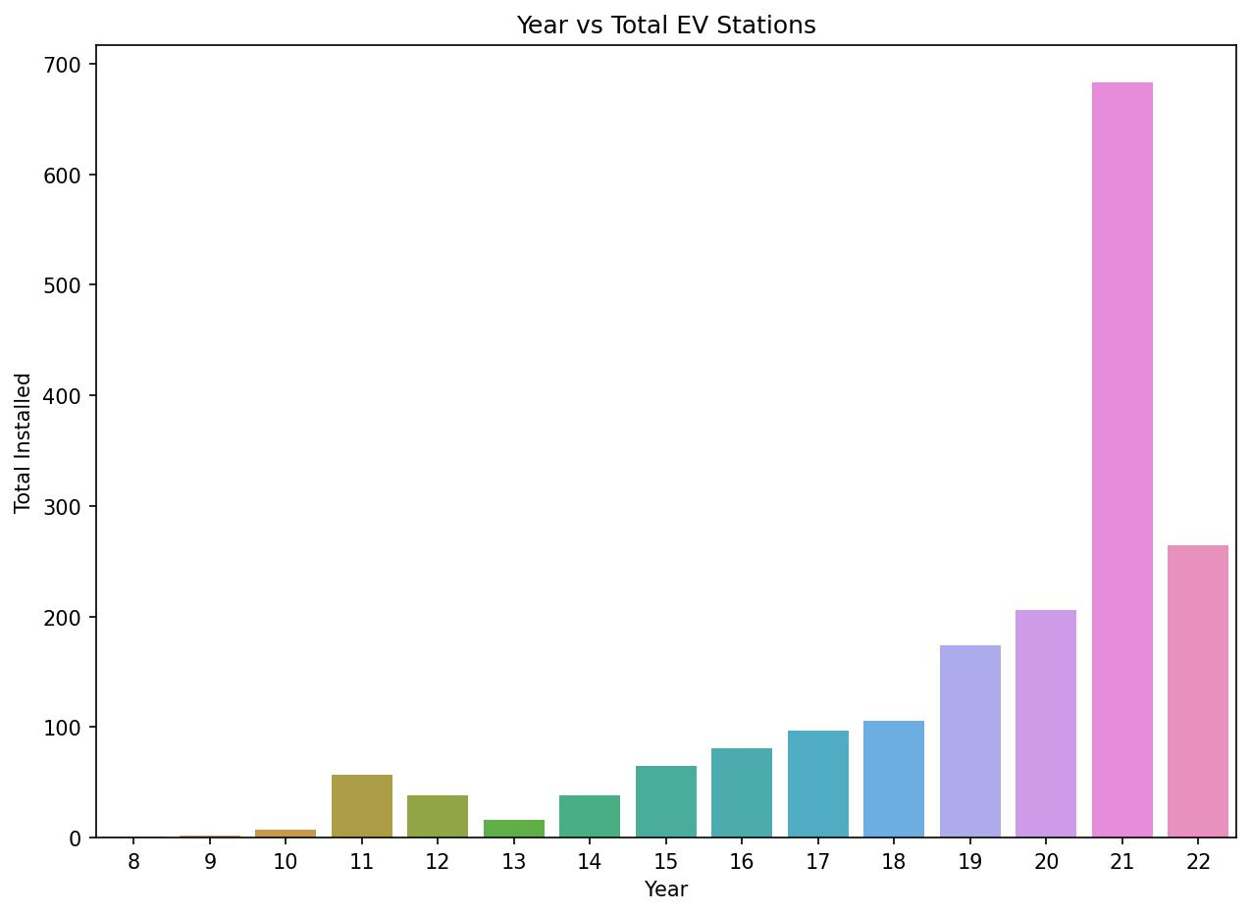
Electric Vehicle Charging Stations
Total Number of Current Stations
Total Number Until 2021: 1,571 Stations
Total Stations to Date: 1,834

Slide 10
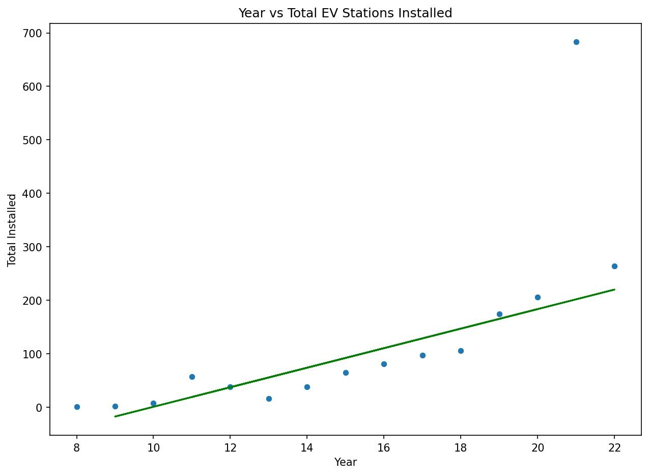
Charging Stations Predictions
Slope: 18.27865961
Intercept: -182.2962963
MSE: 886.2391534391534
RMS error: 29.769769119681687
R2 score: 0.8650966972163299

Slide 11
Charging Stations Predictions
Total Number of Predicted Stations
Total Predicted Stations from
2022 to 2033: 3625

Slide 12
Current Stations Long and Lat
Models used for predictions
K_{NN}
TPOT
Keras Neural Network

Slide 13
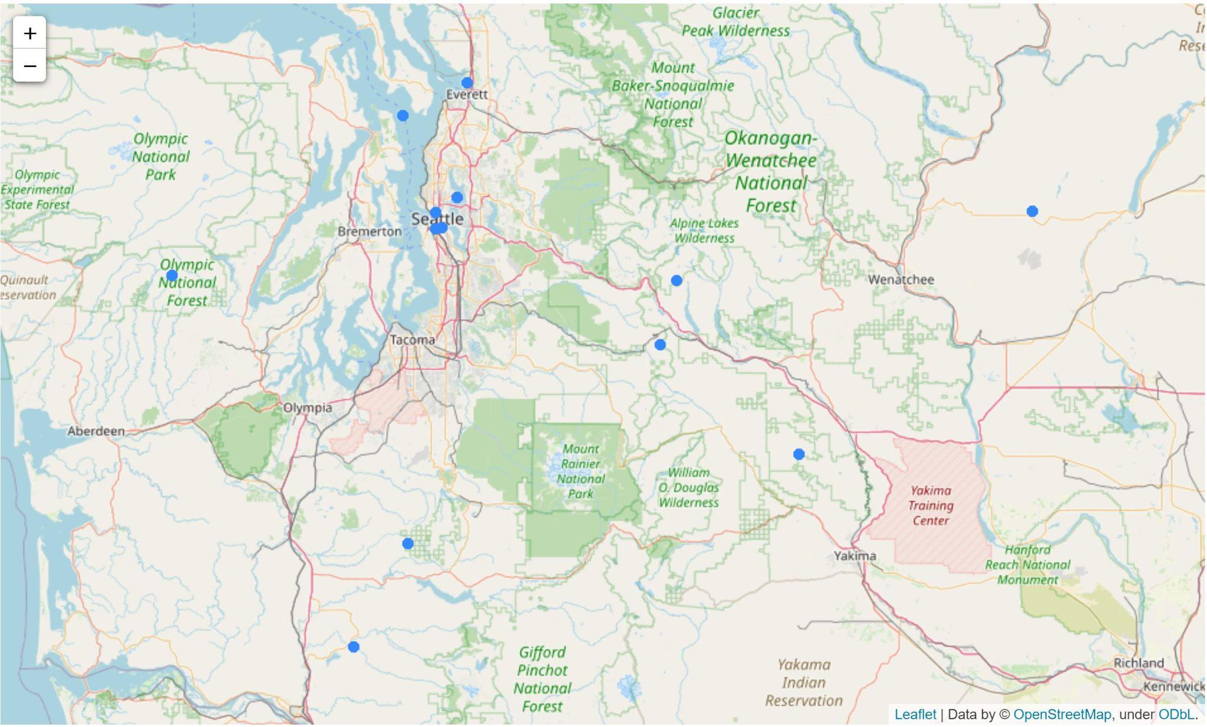
K_{NN} - Stations Long and Lat Predictions
RMS:
Latitude 0.792931
Longitude 1.505775
Neighbor size of 2 was best

Slide 14
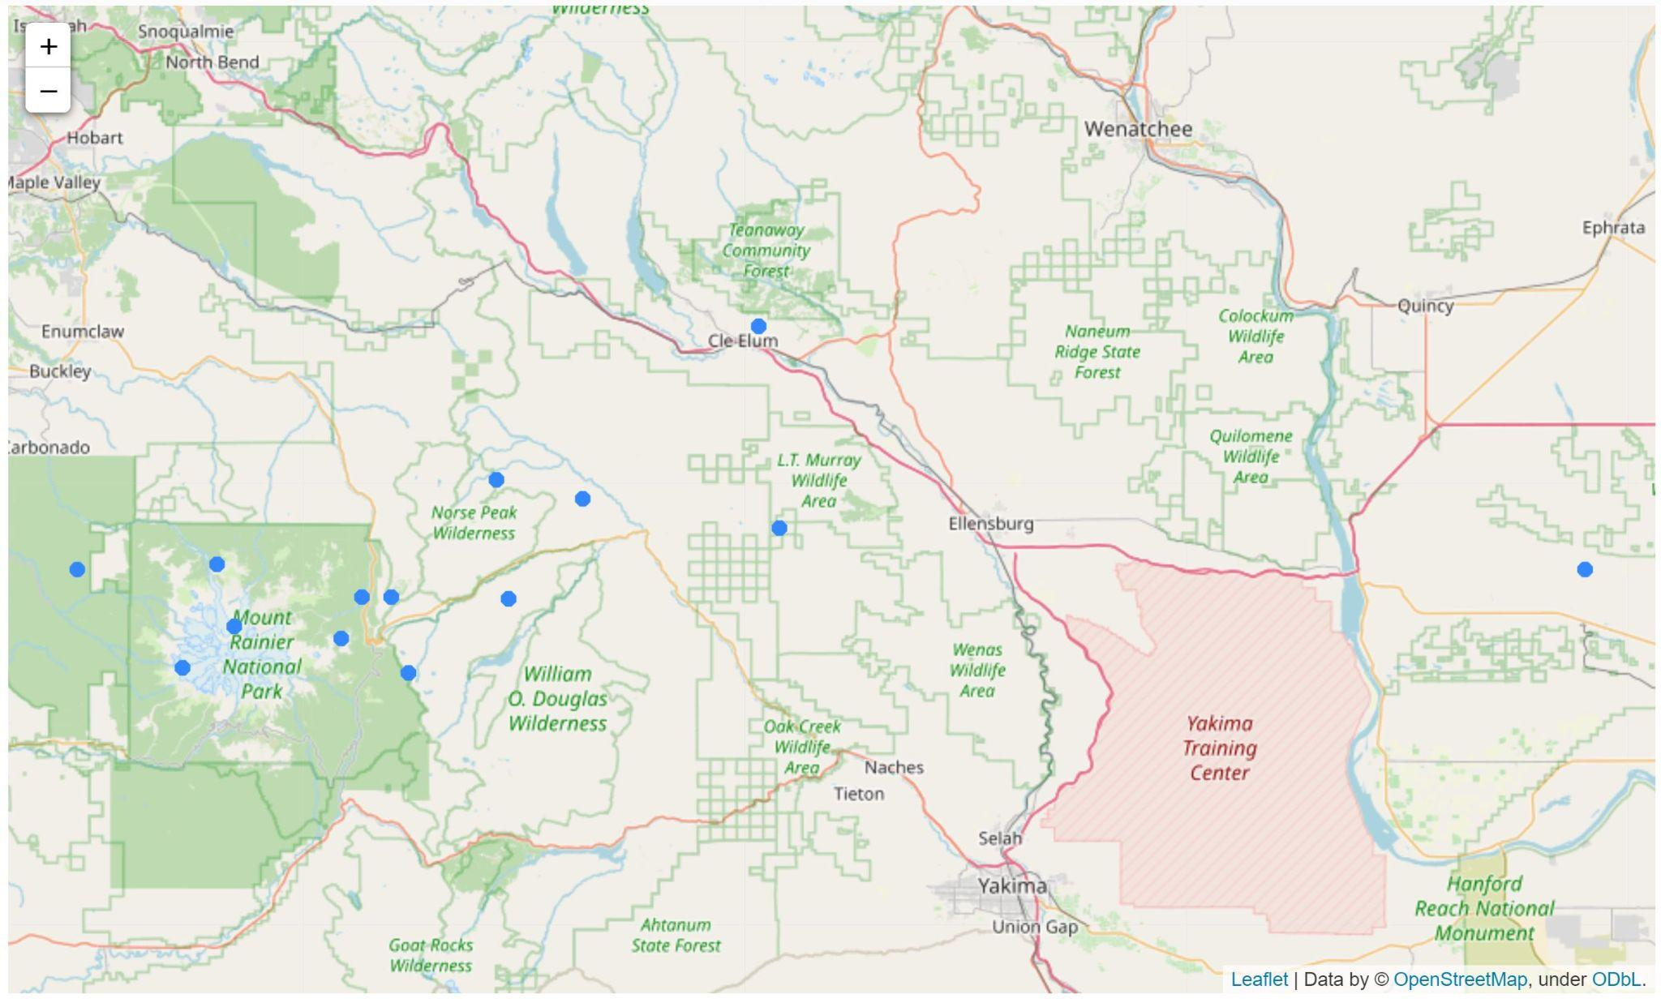
TPOT - Stations Long and Lat Predictions
TPOT for Longitude chose to use K_{NN} as well with a neighbor size of 86.
Score: -1.8074337738920678
TPOT for Latitude chose to ExtraTreesRegressor
Score: -0.3358116447193641

Slide 15
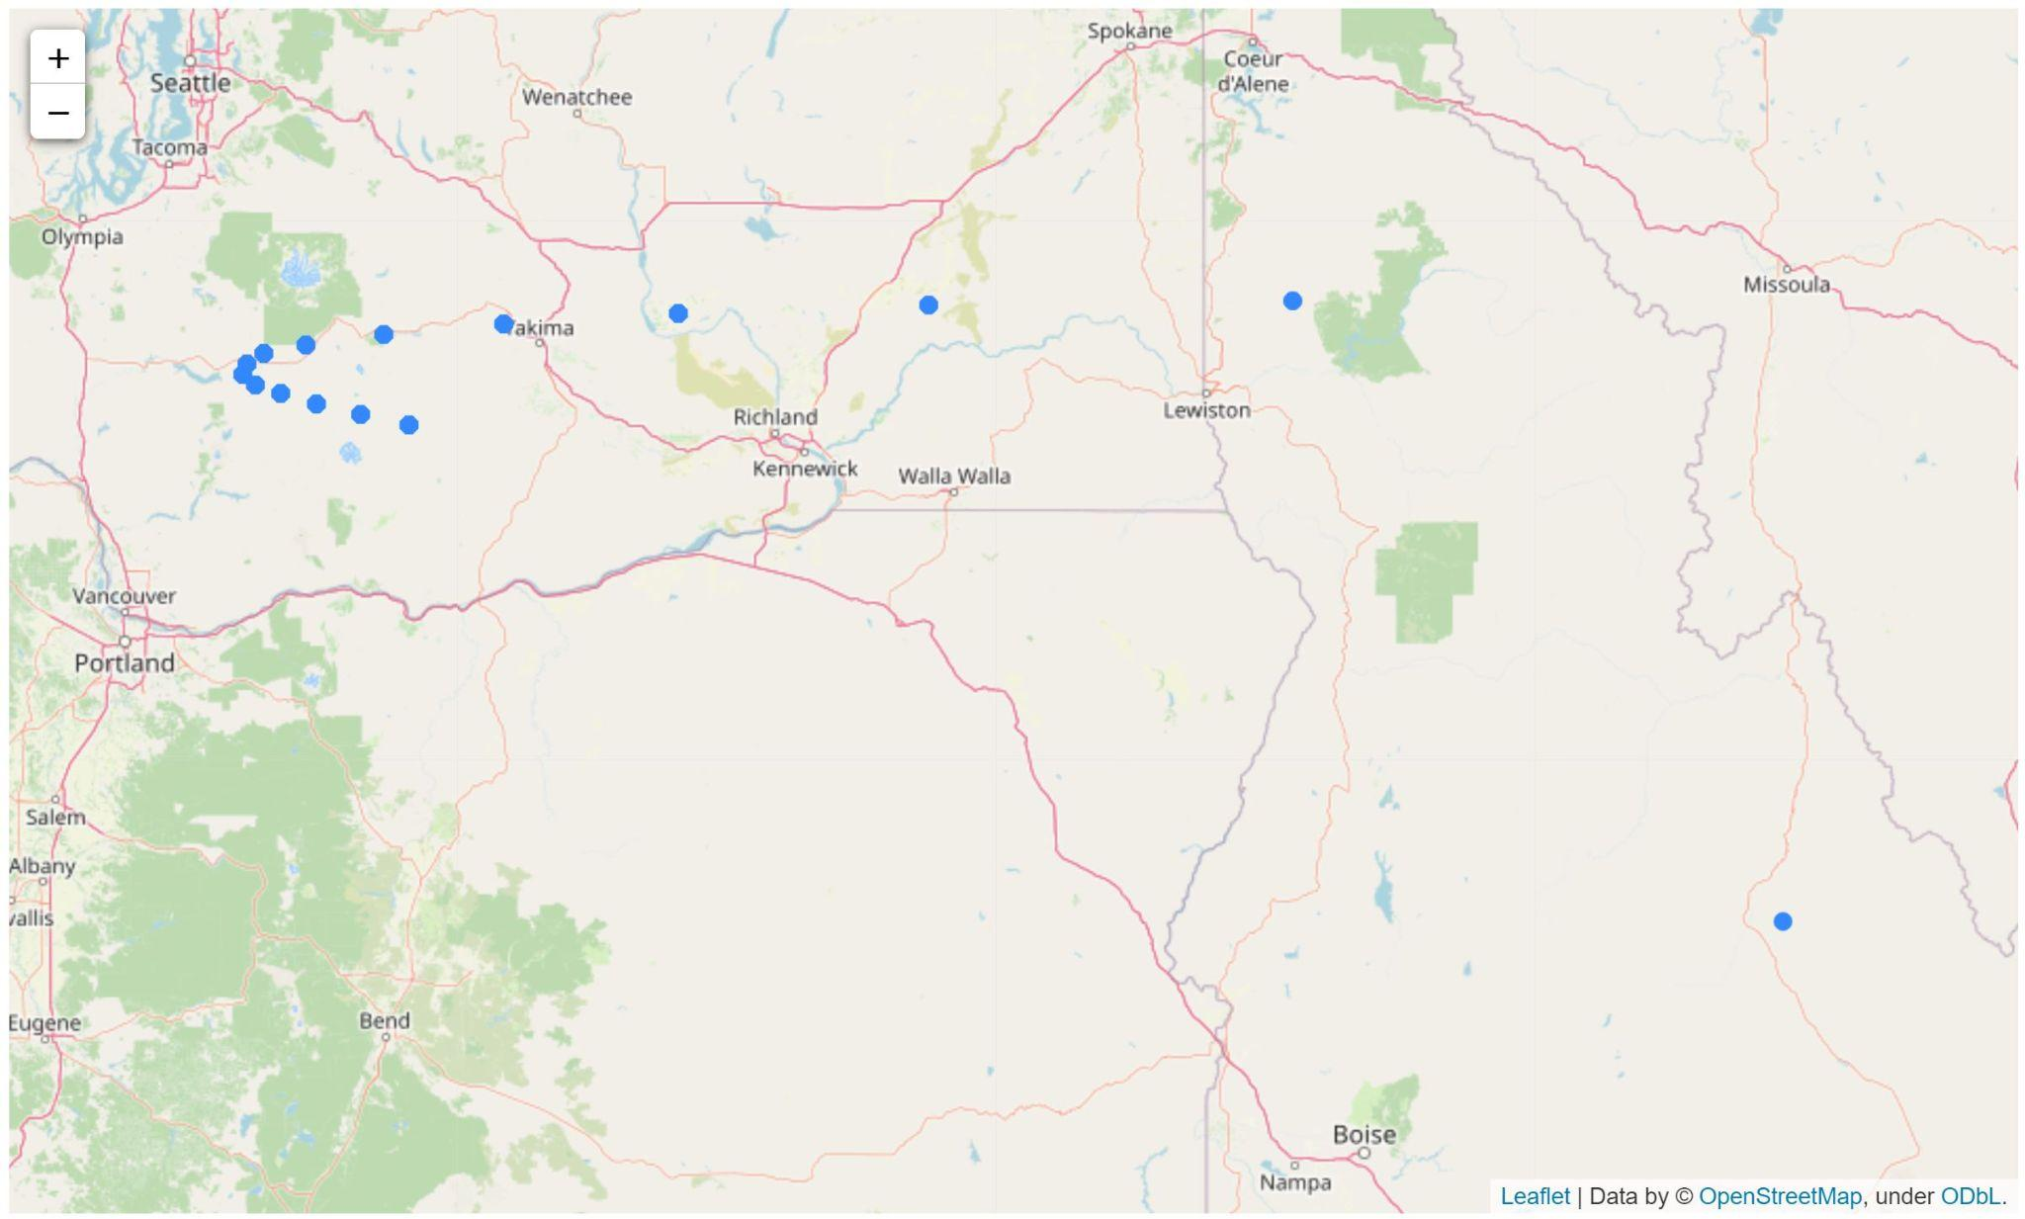
NN - Stations Long and Lat Predictions
Activations Layers Chosen:
Selu
Loss: 2.2477

Slide 16
Issues Faced
Could not import EV data due to wrong shape of data
Plotted stations ontop of each other
Neural Network predicted longitude wrong due to loss of 1000+
Activations Layers Tried:
Softplus, Selu, Relu, elu, Sigmoid, Tanh, Softmax, Softsign, Exponential

Slide 17
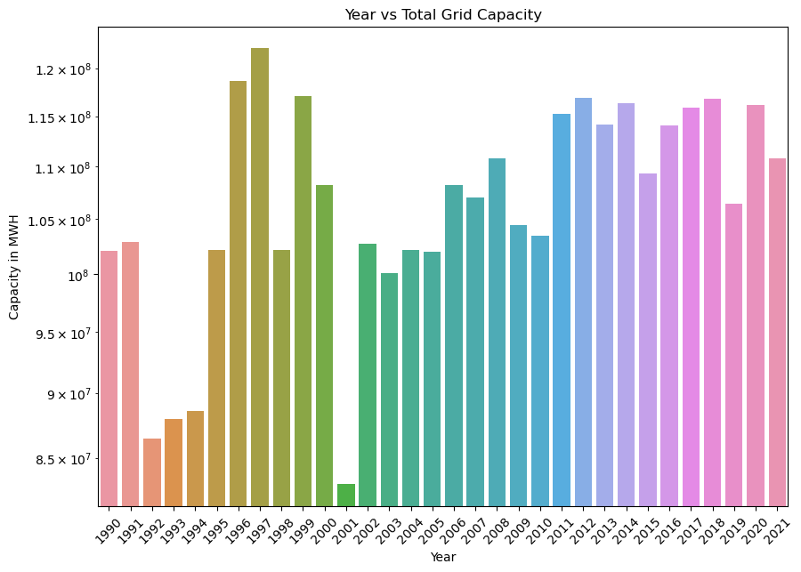
Annual Generation dataset
From US EIA (Energy information Administration)
Includes all 50 States
Splits data by source
(Solar, Nuclear, etc)
Notes:
We created a Neural Network with the purpose of predicting the stability of EV generation for Washington state, and we graphed the data via linear regression.
We separated them into various renewable and non-renewable sources, such as Wind, Coal, Natural Gas, etc. This was done in order to better understand which energy source is predicted to be most/least effective in the future.
The total values for each year were used for simplicity, so that the entire year would be accounted for. The original data also entailed data from 1960 to 2021, however it was condensed to 1990 to 2021 in order to prioritize more recent data.

Slide 18
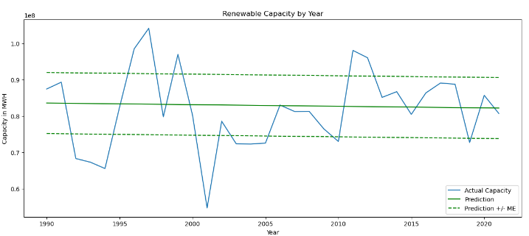
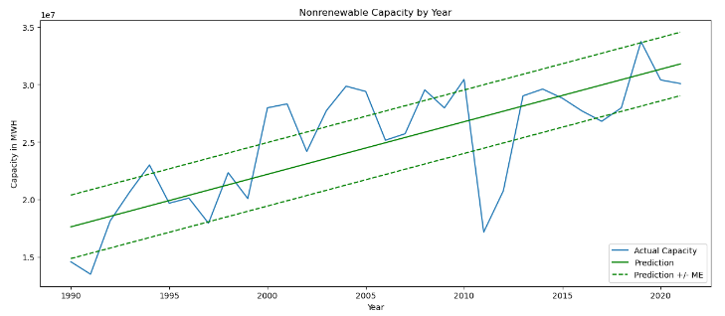
Renewable vs Non renewable
Notes:
These are the graphs for Renewable and Nonrenewable energy sources for Washington state. It is worth noting that the renewable energy capacity is going down slightly, whilst the nonrenewable capacity is going up. After doing a little bit of research, a potential reason for this can be determined to be that 65% of Washington state's power comes from hydroelectric, and that therefore it isn’t easy to supply more hydroelectric stations. Washington state is one of the most decarbonized states in the US, so this trend is a good indication of the direction other states should strive for.

Slide 19
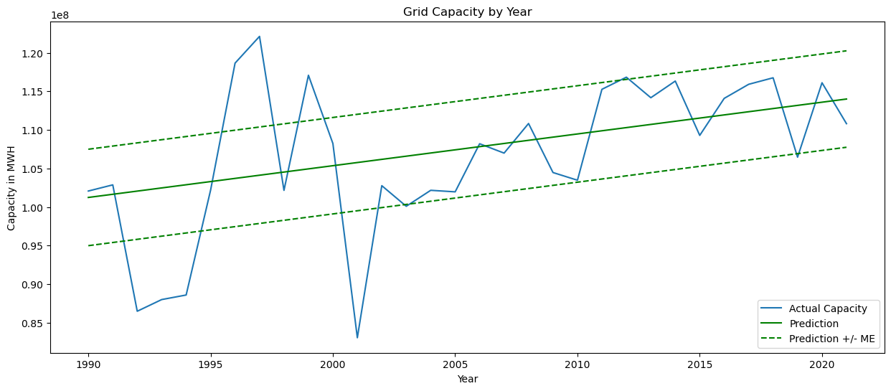
EV Generation prediction
Mean Error: 6254128.057123018
MSE: 70829600173261.72
Root mean squared error: 8416032.32972313
R2 score: 0.25162451506693917
Notes:
This is the linear regression model. The two green are the mean variation and mean error, and shown in the legend. This projection shows that over the course of 30 years, the stability for the EV grid will steadily get better over time, as well as the overall capacity in MWH. It is worth noting that there was a spike in the capacity during the 97’s.

Slide 20
Issues Faced
Lack of Abundant Data
Causes high error
Low Accuracy (R2 score of 25%)
Time Series Regression
Difficult to make an accurate model
Could use an RNN
Current prediction is a wide range

Slide 21
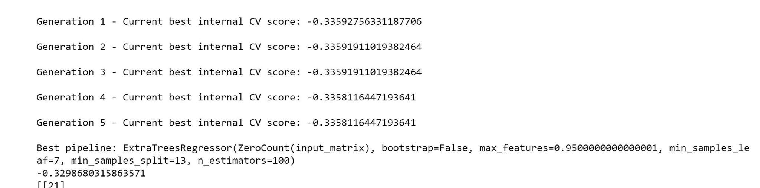
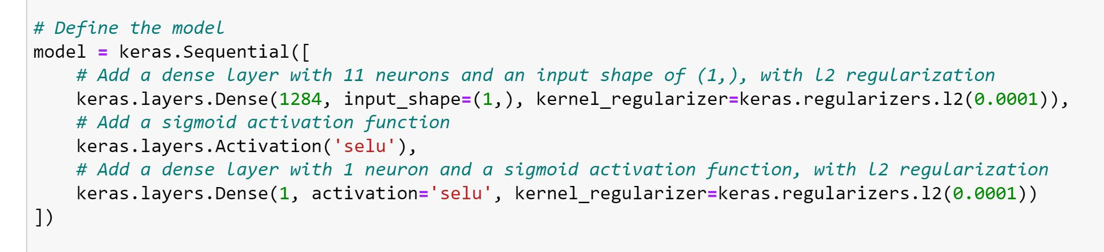
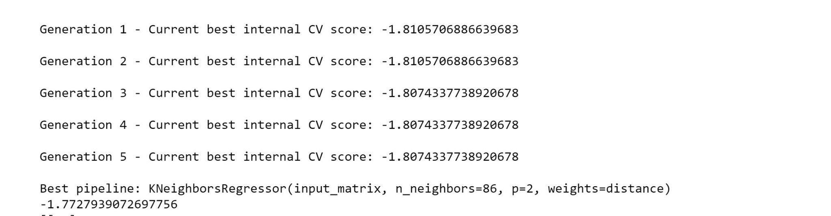
Backup Slides: EV Stations

Slide 22
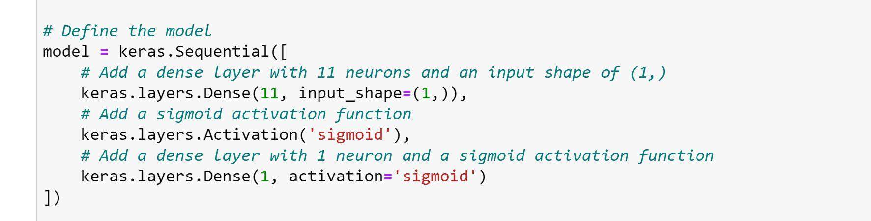
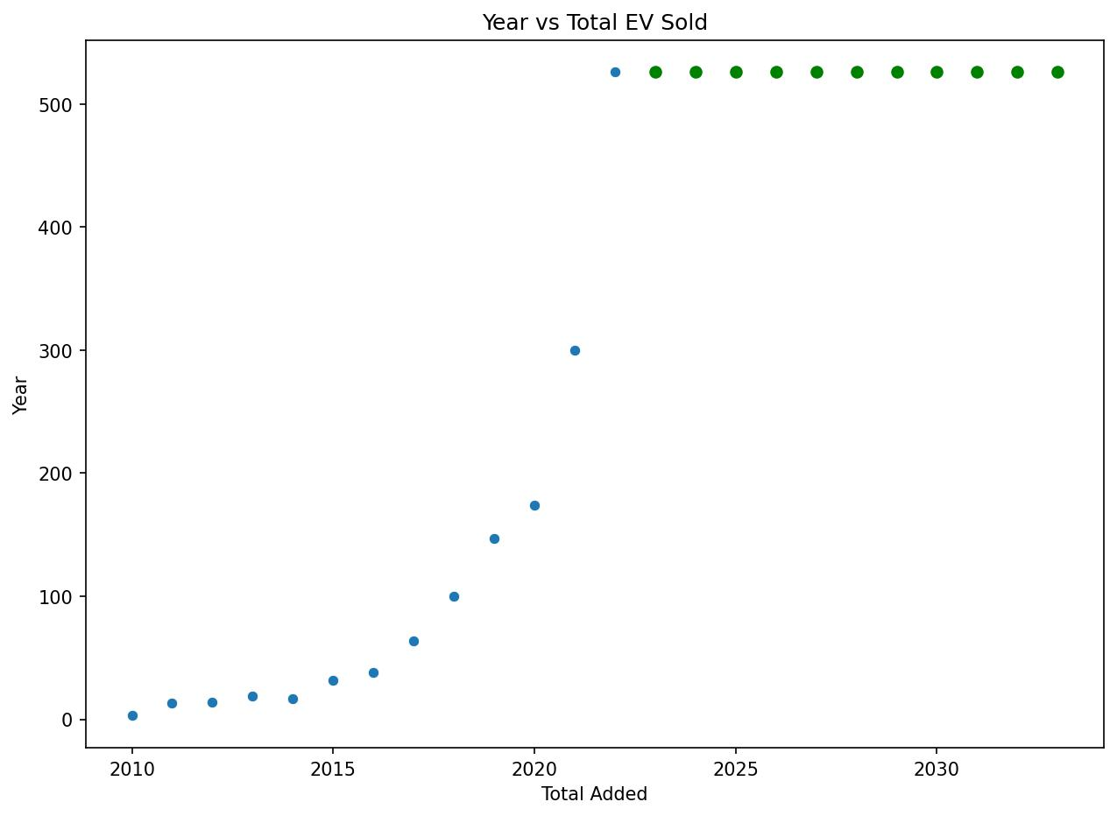
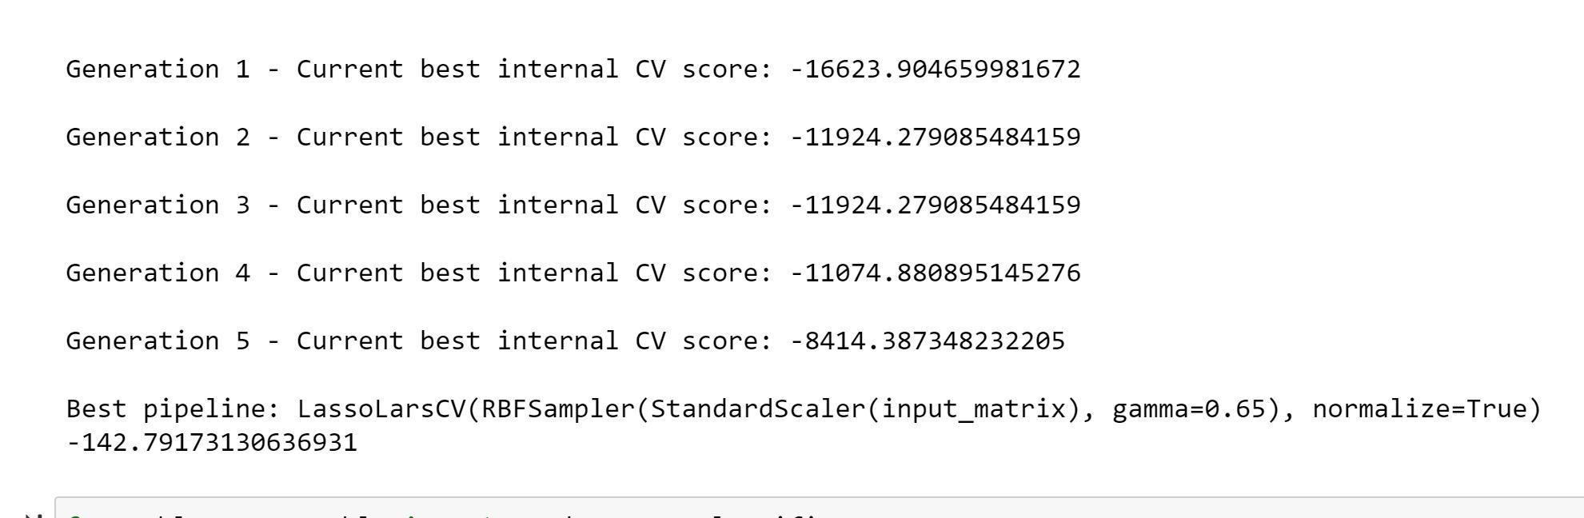
Backup Slides: EV Vehicles

